Slide 1
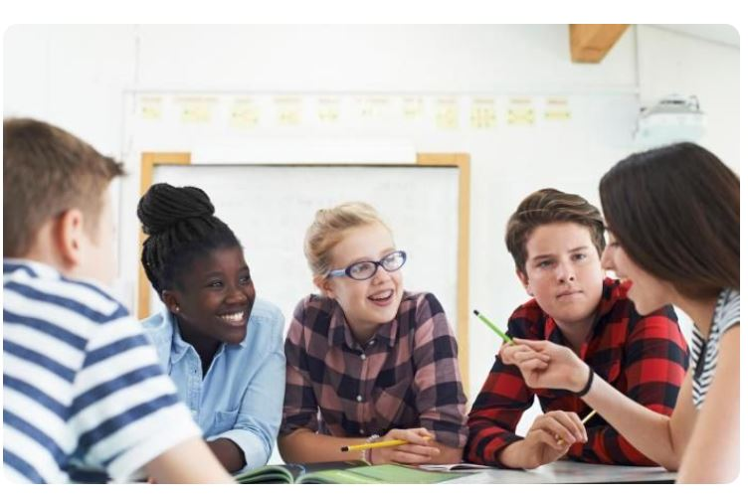
When you work with other students, you do… ????
Team Work
They are 5 …. ?
Teammates

Slide 2
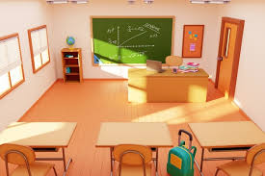
Board

Slide 3
Desk

Slide 4
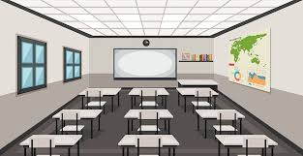
There are 3 rows of desks in the classroom

Slide 5
You can walk in the two aisles

Slide 6
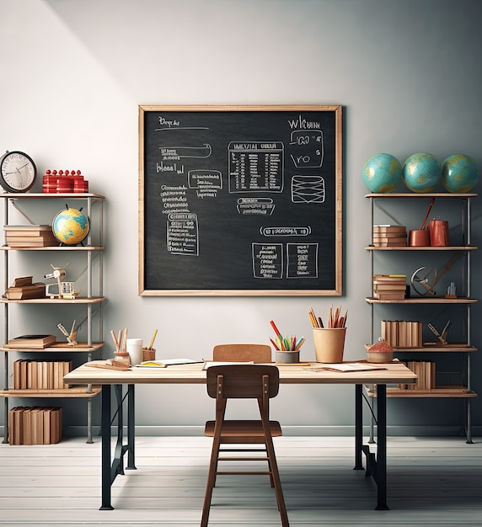
Bookcase
Bookcase
Shelf (Shelves)

Slide 7
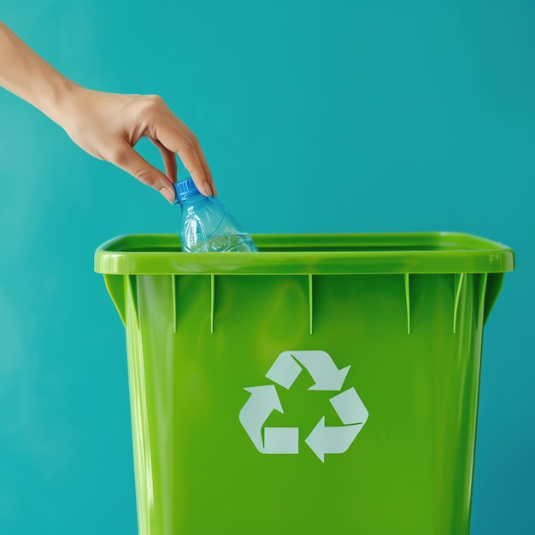
Recycling Bin

Slide 8
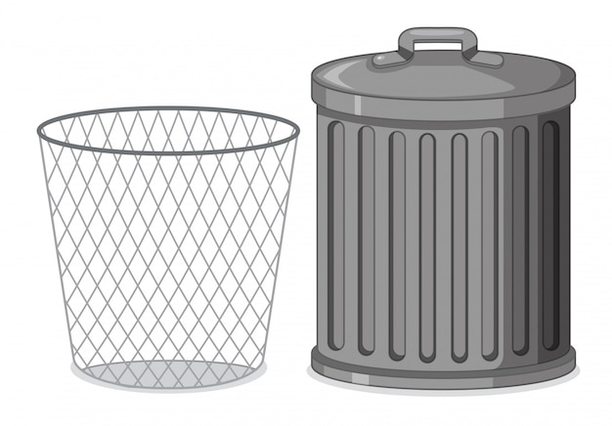
Waste paper basket (trash can, garbage)

Slide 9

Clock

Slide 10
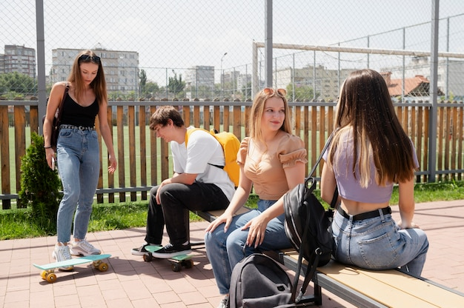
From 10:35 A.M.
To 10:50 A.M.
From 2:35 P.M.
To 2:50 P.M.
What do you have?
Recess

Slide 11

Remote control

Slide 12
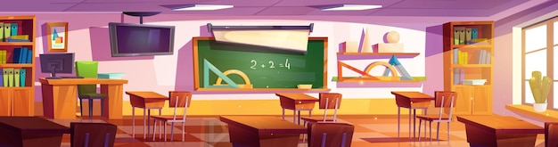
Ceiling
Wall
Floor

Slide 13
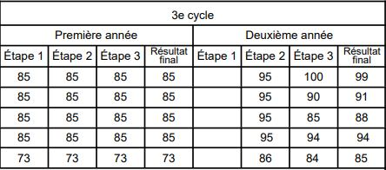
French, Math, English, Geography, History, … you have Bulletin =
Report Card
Every 3 months (november, march, juin)
Term
Grade

