Slide 1
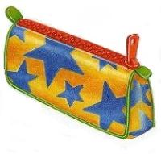
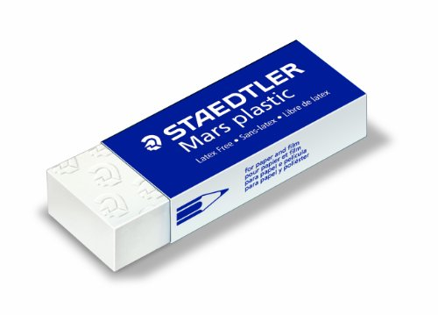
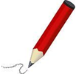
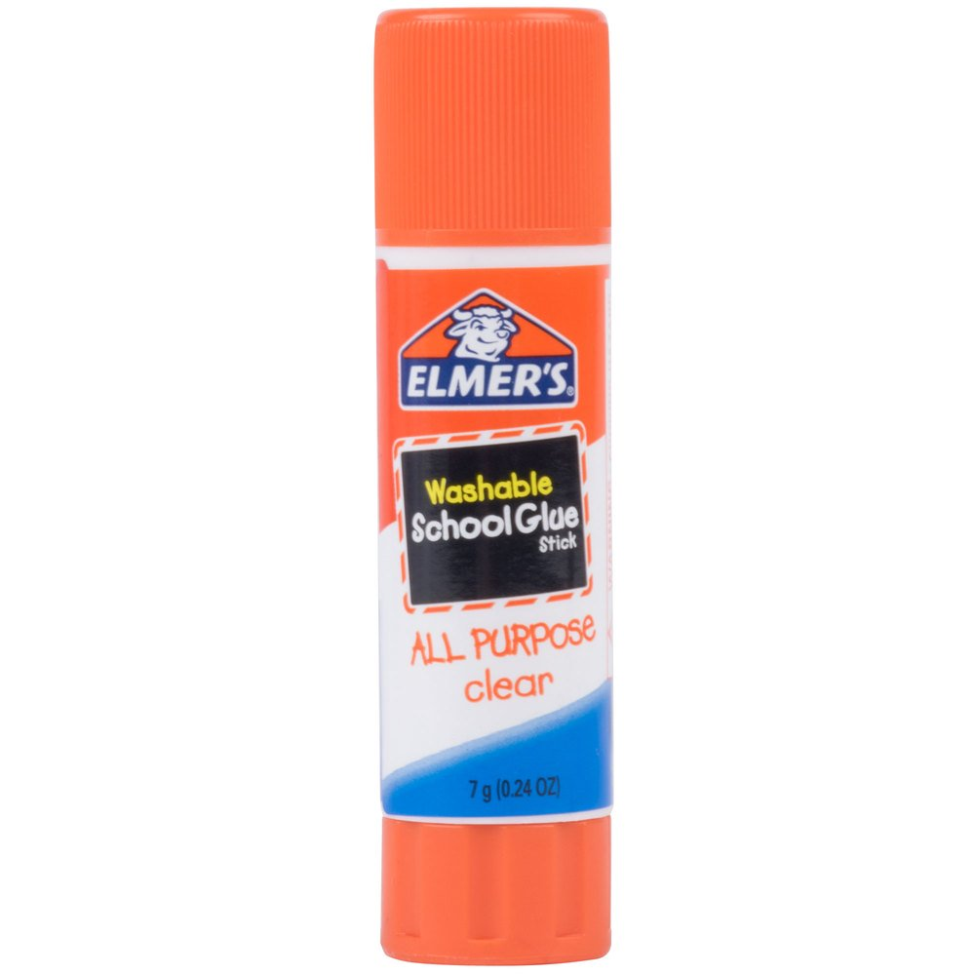
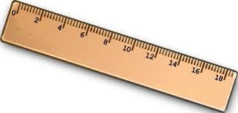

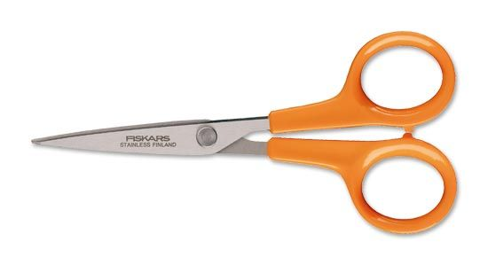
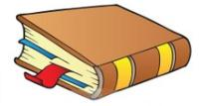

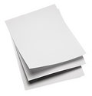

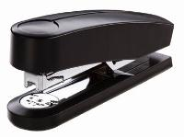
Eraser
Pencil case
Pencil
Ruler
Glue
Scissors
Sharpener
Stapler
Book
Paper clip
Notebook
Paper

Slide 2
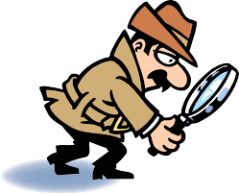
Are you a good detective?

Slide 3
Eraser
Pencil case
Pencil
Glue
Ruler
Scissors
Sharpener
Book
Stapler
Paper clip
Notebook
Paper

Slide 4
What object is missing?

Slide 5
Eraser
Pencil case
Pencil
Ruler
Glue
Scissors
Sharpener
Stapler
Book
Notebook
Paper clip
Paper

Slide 6
What object is missing?

Slide 7
Eraser
Pencil case
Pencil
Ruler
Glue
Scissors
Sharpener
Stapler
Book
Paper clip
Notebook
Paper

Slide 8
What object is missing?

Slide 9
Eraser
Pencil case
Pencil
Ruler
Glue
Scissors
Sharpener
Stapler
Book
Paper clip
Notebook
Paper

Slide 10
What object is missing?

Slide 11
Eraser
Pencil case
Pencil
Glue
Ruler
Scissors
Sharpener
Stapler
Book
Paper clip
Notebook
Paper

Slide 12
What object is missing?

Slide 13
Eraser
Pencil case
Pencil
Ruler
Glue
Scissors
Sharpener
Stapler
Book
Paper clip
Notebook
Paper

Slide 14
What object is missing?

Slide 15
Eraser
Pencil case
Pencil
Ruler
Glue
Scissors
Sharpener
Stapler
Book
Paper clip
Notebook
Paper

Slide 16
What object is missing?

Slide 17
Eraser
Pencil case
Pencil
Ruler
Glue
Scissors
Sharpener
Stapler
Book
Paper clip
Notebook
Paper

