Slide 1
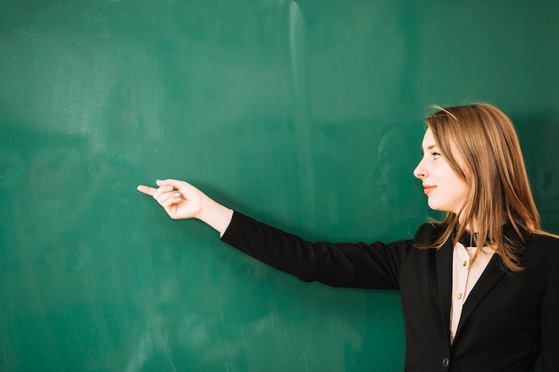
Teachers use it to write on …
Board

Slide 2
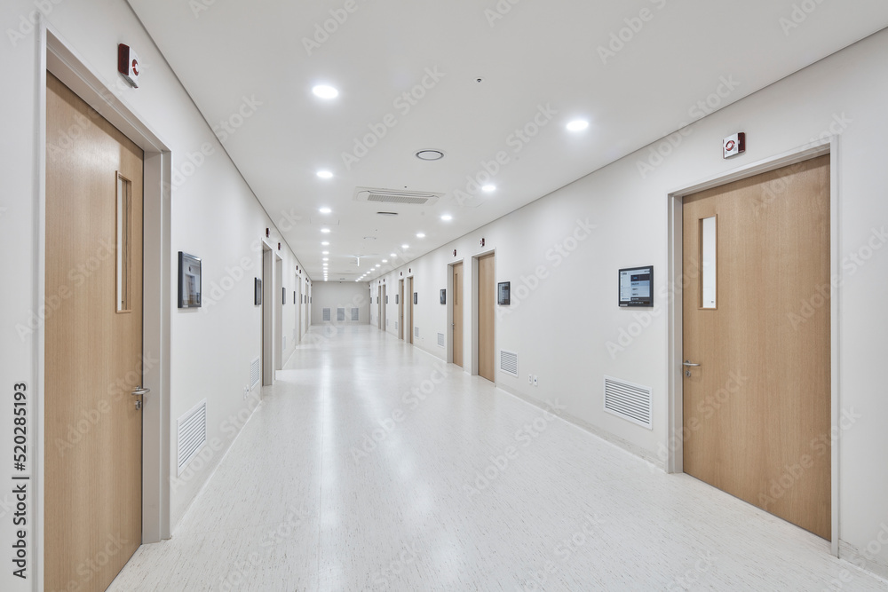
A place where you walk when you are between classrooms
Hallway

Slide 3
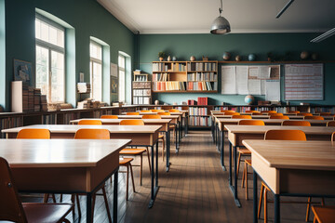
The space between two rows of desks…
aisle

Slide 4
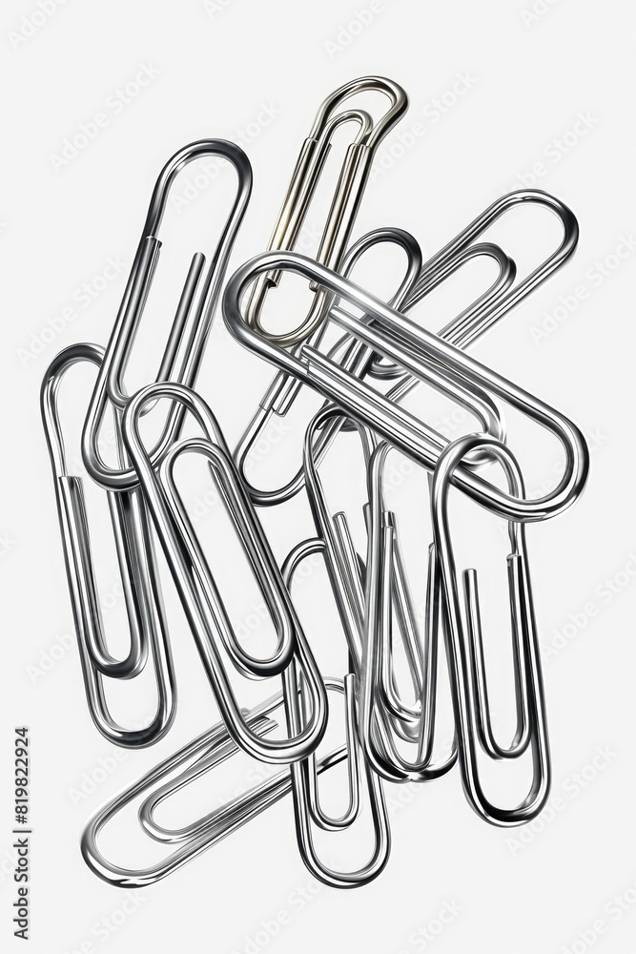
What do we use to attach paper together?

Slide 5
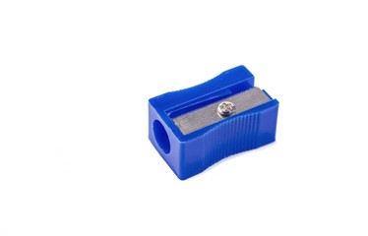
When the tip of your pencil is not working well, you need to use a …

Slide 6
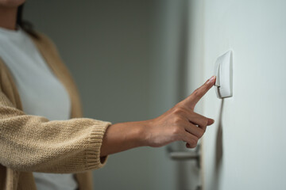
What do you say when you want some lights in the class…
Turn on the lights

Slide 7
1 019 686
One million nineteen thousand six hundred eighty-six

Slide 8
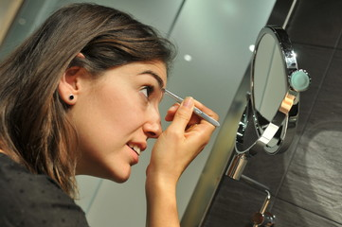
On what part of her face does she put on make up?
eyebrows

Slide 9
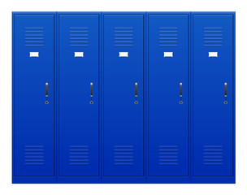
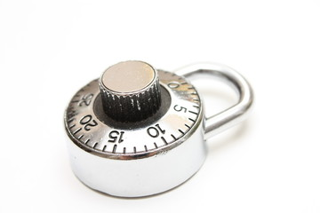
Where do you put all your books and your coat?
locker
lock

Slide 10

Forehead
lips
Chin

