Slide 1
Present Progressive

Slide 2

What is this person doing?

Slide 3

What is this person doing?

Slide 4
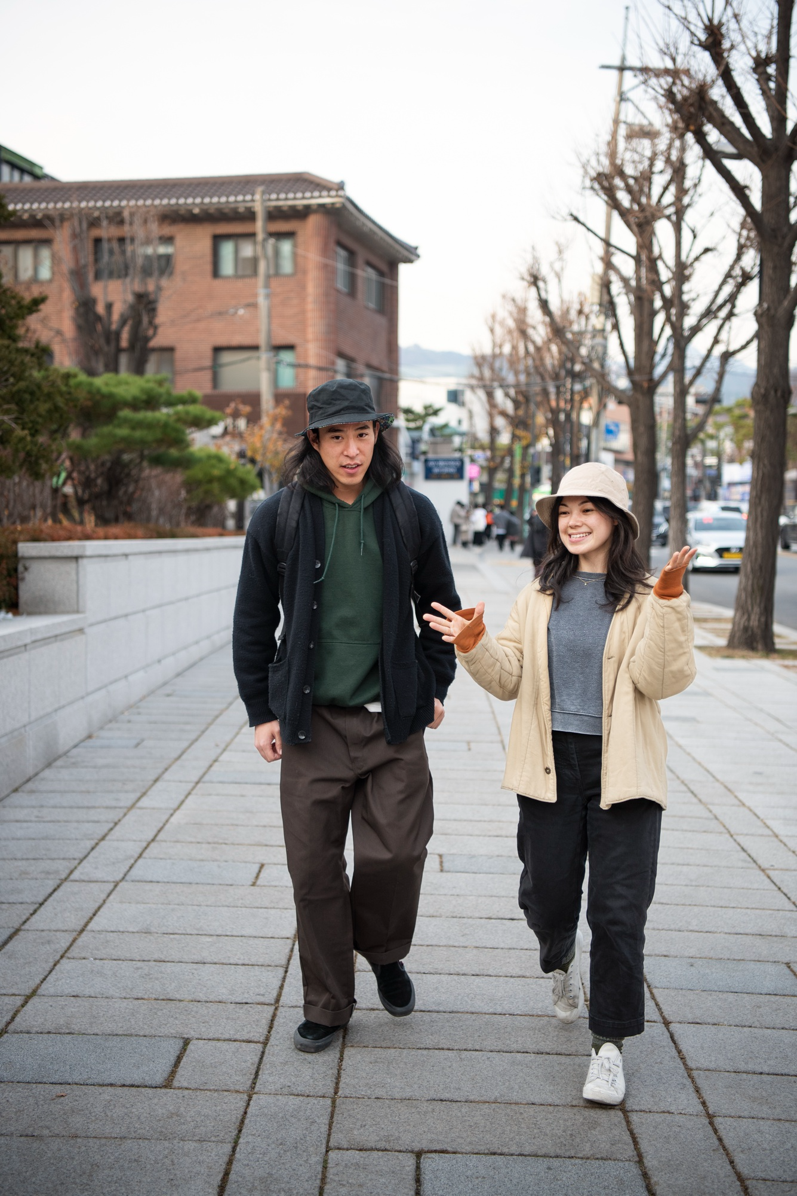
What is this person doing?

Slide 5
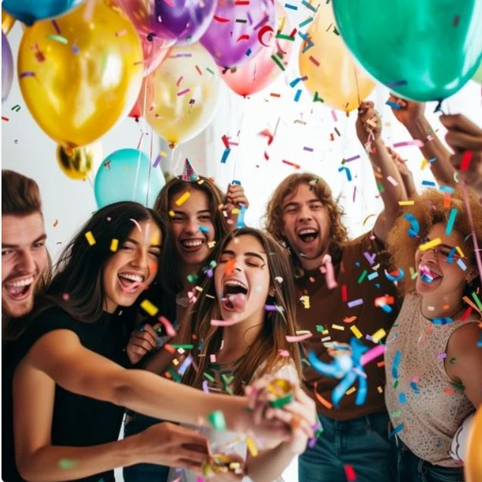
What are they doing?

Slide 6
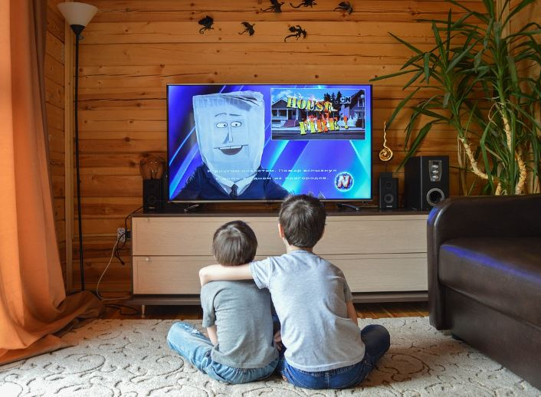
What are they doing?

Slide 7
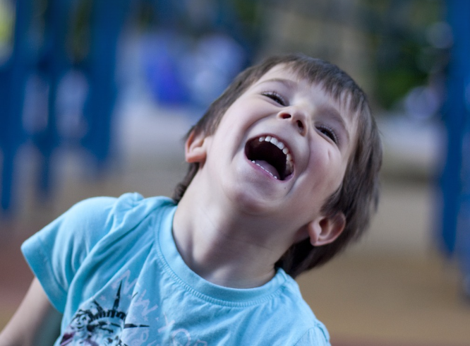
What is he doing?

Slide 8
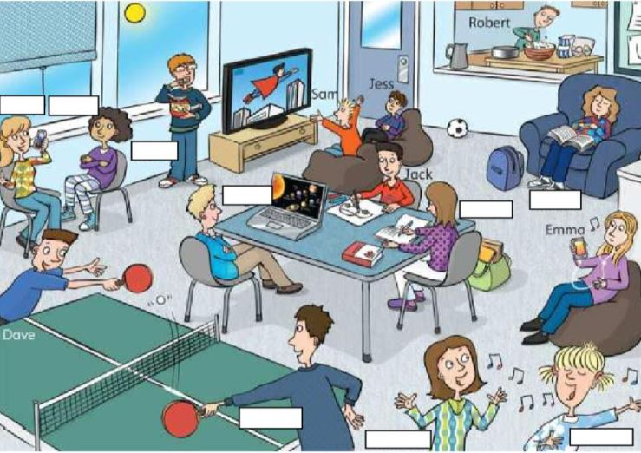

Slide 9
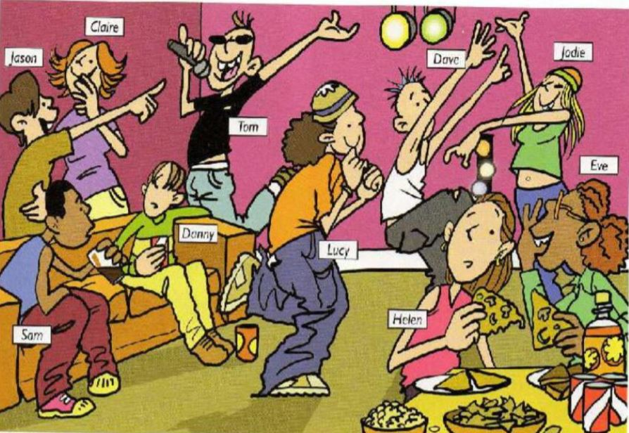

Slide 10
